Slide 1

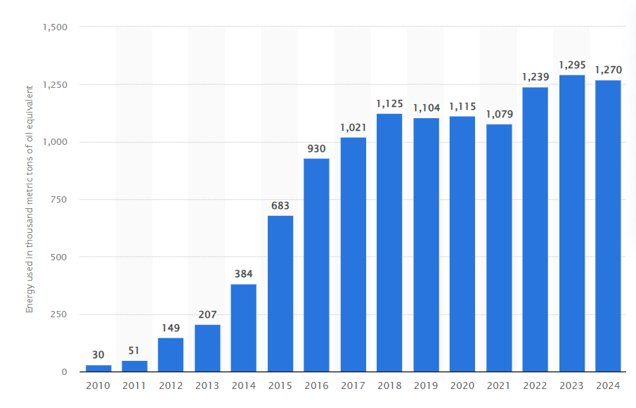

Sustainable Market Entry for Solar Technology: LumiCharge’s Expansion into the UK
Student Name: Rana Koteswara Rao Mangineni
Student ID: S24013995
Issues: Sustainable international market entry for clean-tech products.
Porter’s Five Forces for LumiCharge (UK Market)
Threat of New Entrants: Moderate, as solar technology is accessible but requires investment and technical expertise.
Bargaining Power of Buyers: High, due to many alternative charging options and price sensitivity.
Bargaining Power of Suppliers: Moderate, because quality solar component suppliers are limited.
Threat of Substitutes: High, with power banks and grid charging widely available.
Competitive Rivalry: Moderate, as few brands offer premium solar charging solutions.
Key Findings & Critical Insights
Strong growth in UK energy consumption highlights rising demand for alternative and sustainable power sources.
Limited availability of premium solar chargers creates a clear market gap for LumiCharge.
UK consumers value eco-friendly, portable, and reliable charging solutions.
Notes:
Introduction
Chosen Issue / Concept: This is a project on sustainable international market entry into clean-tech products and in this case, LumiCharge solar-powered charge pods are the business case.
Why This Matters: This is a problem as foreign entrepreneurs have to juggle through market requirements, cultural expectations and sustainability objectives entering foreign countries. The increasing eco-consciousness, abundant smartphone use, and need to have a portable energy supply in the UK make the solar technology developed by LumiCharge commercially feasible and socially beneficial.
Research Process
To collect information to support this project, I used academic periodicals, industry reports, and valid databases of market research. The most important scholarly resources were the discussion of solar cell technologies by Hirwani (2025), allowing one to understand the current developments and their effects on sustainability, and an article by Michail (2021), presenting the examples of efficient solar-powered mobile charging. These are peer-reviewed publications that provide established technical principles of solar innovation. There was a steep increase in energy use in UK, which grew by 149 thousand Mtoe in 2012 to 1,270 thousand Mtoe in 2024, although there was small decline in 2020 (1,115) and 2021 (1,079) (Statista, 2024). The gradual escalation since 2015 (683) can be attributed to the growth in energy demand due to the growing use of digitalisation, mobility and technology which proves that sustainable and alternative energy sources like solar-powered appliances are a necessity.
Theoretical Framework
Porter’s Five Forces Model: In this project, the Five Forces of Porter are practically used to assess the competitive position of LumiCharge in the UK solar charging market critically. The threat of the new entrants is medium as though the technology is available reliable and efficient production of solar necessitates technical skills and financial input. The bargaining of buyers is strong as there are multiple alternative charging products, which compel LumiCharge to focus on differentiation strategy based on sustainability and innovation. The supplier power is moderate as solar components can be sourced worldwide but quality suppliers are scarce (Heaton et al., 2023). The intensity of threat of substitutes is high (power banks and public charging points) and exert more pressure on the competition. Lastly, the level of rivalry in the industry is moderate because there are not many companies providing high-quality solar chargers, and LumiCharge will be able to take an advantageous position.
Insights and Analysis
Key Research Insights: The three main messages in the research are identified. To begin with, the increasing demand of green technology in the UK indicates the presence of a good market in solar-powered charging solutions. Secondly, quality and innovation can be used to fill in a competitive gap as there are no high-end solar chargers among competitors (Rieder et al., 2025). Third, the consumer lifestyles based on mobility, tourism and outdoor activities create more requirements to portable energy.
Entrepreneurial Relevance: These lessons are relevant to international entrepreneurs as they can show that by matching a product with the local sustainability aspects, lifestyle, as well as unsatisfied needs, the likelihood of entering the market and enhancing its adoption can be lowered (Mehdi Veisi, 2025). By integrating business models that provide entrepreneurs with insights into the market and cultural and competitive analysis, there is a better chance of developing differentiated business models that are scalable globally.
Conclusion
The following infographic adds a clear and visually interesting insight into the influence of sustainability, consumer demand, and competitive forces to the entry of LumiCharge into the UK market. Integrating Porter's Five Forces, market research and consumer intelligence, it demonstrates why a high-end solar-powered charging option can prove commercially and ecologically successful. The images distil complicated international business theory and present it in a way that an entrepreneur is able to grasp how strategic analysis aids informed decision-making in introducing clean-technology products into international markets.

Slide 2
References
Heaton, A.G., Sung, K. and Patrick (2023). ACCESSIBLE SOLAR ENERGY TECHNOLOGY FOR DOMESTIC APPLICATIONS IN THE UK: EDGE SOLAR. Proceedings of the Design Society, 3, pp.445–454. doi:https://doi.org/10.1017/pds.2023.45.
Hirwani (2025). ADVANCEMENTS IN SOLAR CELL TECHNOLOGIES AND THEIR MULTIFACETED APPLICATIONS IN A SUSTAINABLE FUTURE. [online] Available at: https://www.ijprems.com/uploadedfiles/paper/issue_5_may_2025/41252/final/fin_ijprems1747920612.pdf.
Mehdi Veisi (2025). Stochastic economic placement and sizing of electric vehicles charging station with renewable units and battery bank in smart distribution network. Scientific Reports, [online] 15(1). doi:https://doi.org/10.1038/s41598-025-10391-6.
Rieder, D., Louis, J. and Wilfried Elmenreich (2025). Life cycle assessment of portable charging technologies—a case study of a solar charger and a power bank. The International Journal of Life Cycle Assessment. doi:https://doi.org/10.1007/s11367-025-02453-8.
Sanitha Michail, C. (2021). An Innovative Way Of Implementing Efficient Mobile Charger Powered By Solar Energy. IOP Conference Series: Materials Science and Engineering, 1070(1), p.012091. doi:https://doi.org/10.1088/1757-899x/1070/1/012091.
Statista (2024). UK: solar energy use for electricity and heat 2024| Statista. [online] Statista. Available at: https://www.statista.com/statistics/556228/solar-energy-used-for-electricity-heat-uk/?srsltid=AfmBOoqhn41x8CLRPM-1KDthJZIO94wDYO6cY9_CQBnQzXA0Is2IQtev [Accessed 10 Jan. 2026].

